Slide 1


ProgPrompt: Generating Situated Robot Task Plans using Large Language Models
TEAM: Giorgia Grazia Mucciarella
1000069228
Cognitive Computing and Artificial Intelligence Course
University of Catania, Italy

Slide 2
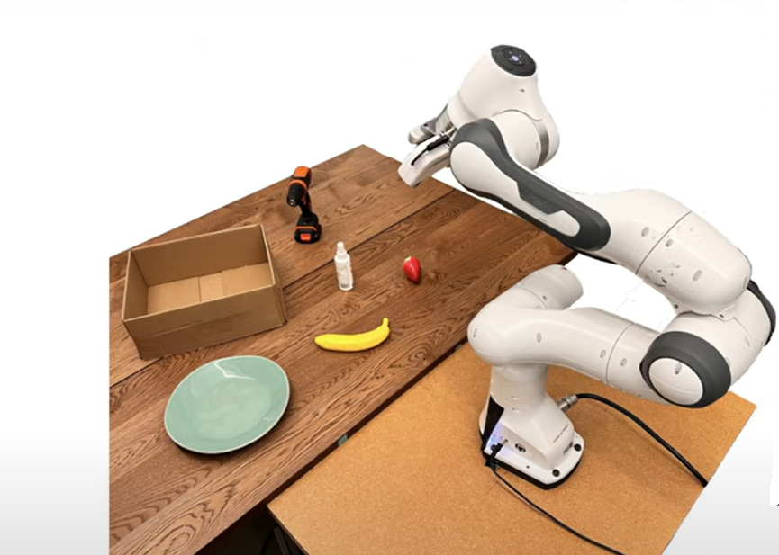
outline
The issue
The technology
The key points
Strengths and weaknesses
Conclusions

Slide 3
The issue
Robots are often required to perform complex and multi-step tasks (e.g., cooking, cleaning, putting away objects).
Large Language Models (LLMs) are highly effective with natural language and world knowledge, but:
They do not always produce reliable, structured, and sequential actions.
Their outputs often lack logical structure and error handling.

Slide 4
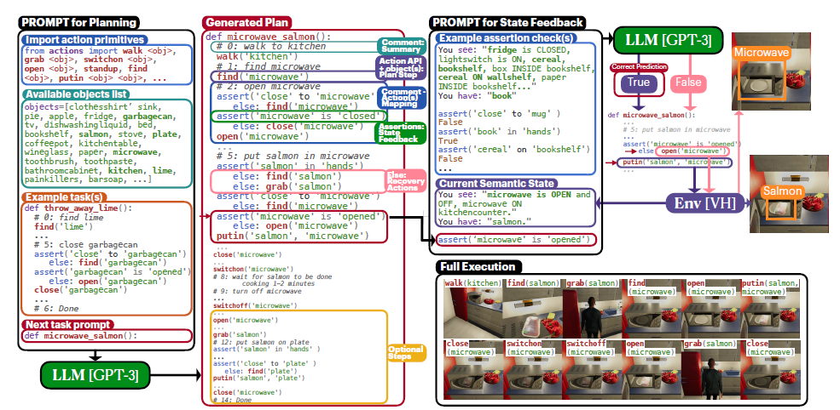
The technology

Slide 5
THE KEY POINTS

Slide 6
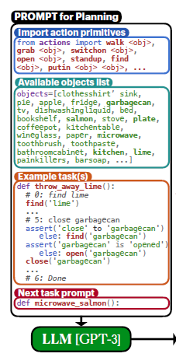
Prompt for Planning
🔹 This is the core of the method: it shows how the prompt is constructed to guide GPT-3 in generating a plan.
🔹 It includes:
Primitive actions (e.g., walk, grab, open, etc.)
A list of objects present in the environment
Example tasks solved with Python code
The instruction given to the model

Slide 7
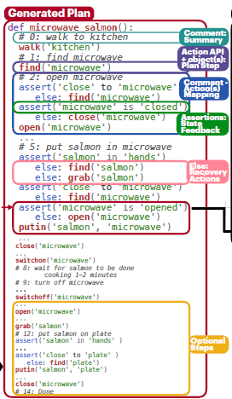
Generated Plan
🔹 This is the Python code generated by GPT-3, for example to “put the salmon in the microwave.”
🔹 The plan is composed of:
Atomic actions (grab, putin, etc.)
State checks (assert)
Automatic corrections

Slide 8
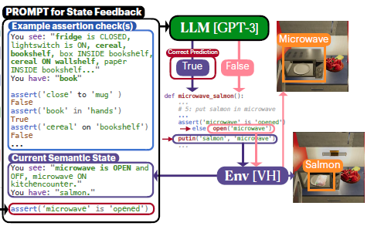
Prompt for State Feedback
🔹 This part monitors the virtual world state during execution.
🔹 It includes:
Logical assertions (e.g., is the microwave open?)
The current state of objects (e.g., “you have the salmon”)
Robot responses: if a check fails, it triggers a correction (e.g., open('microwave'))

Slide 9
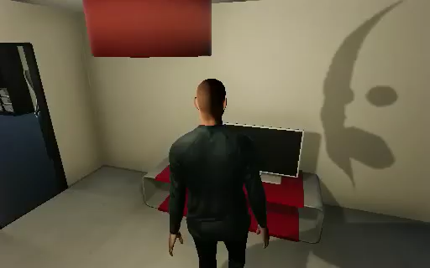
Simulation experiment

Slide 10
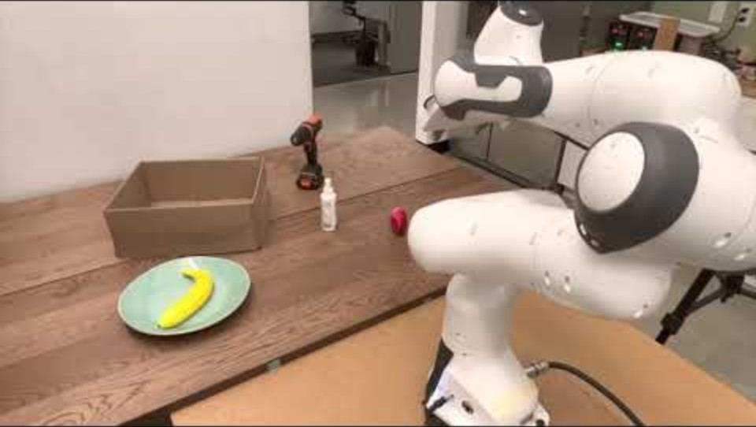
Real robot experiment

Slide 11
STRENGTHS AND WEAKNESSES

Slide 12
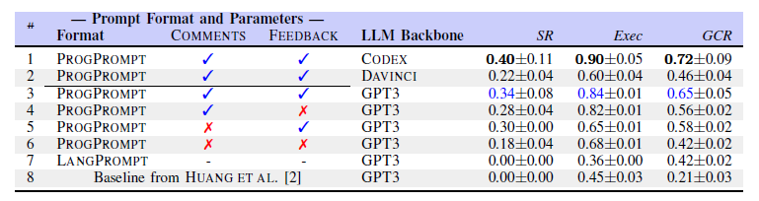
Strengths
Outperforms alternative methods
From Table 1, ProgPrompt clearly outperforms alternative approaches (e.g., natural language prompts or dynamically selected examples).
This shows that a more structured, code-based prompting strategy leads to more reliable and executable plans.
Table I
Notes:
Davinci ha prestazioni inferiori rispetto a GPT3 per LIMITI DI LUNGH DEL PROMPT
CODEX supera GPT3 perché addestrato esplicitam su dati di ling di programmazione però è limitato in termini di query al minuto
SR: la percentuale di successo in cui tutte le condizioni obiettivo rilevanti per il task sono state raggiunte
Executability: la frazione di azioni nel piano che sono eseguibili nell’ambiente, anche se non rilevanti per il task
GCR (Goal Conditions Recall): la differenza tra le condizioni finali di stato corrette e quelle ottenute dal piano generato, diviso per il numero di condizioni obiettivo specifiche del task

Slide 13
Strengths
Real-world applicability
Clear and modular prompt structure
Verified and controlled execution
The method builds a Pythonic prompt with primitive actions, concrete examples, and logical structure, making it easy to understand and execute.
With assert statements and state checks, each action is validated before execution.
The approach is tested in both simulation (VirtualHome) and real robots.

Slide 14
Weaknesses
Environment limitations
LLM output limitations
Incomplete recovery logic
VH agent can't interact with nearby objects while sitting
Some logical actions are missing (e.g., opening TV cabinet)
If an object is inside a container, the plan might not include opening it
No action success feedback → recovery doesn’t always work
Some plans are cut due to token limits

Slide 15
Weaknesses
Ambiguous tasks
Strict evaluation = false failures
Tasks marked as failed even if completed with extra steps
Ex: making coffee, then moving pot → considered failure
Tasks like “prepare dinner” can have multiple valid outcomes
PROGPROMPT adapts well, but automatic evaluation is difficult without human judgment

Slide 16
Critical thinking - Ideas
The paper starts from a concrete problem (the ambiguity of natural language plans) and proposes a structured, pragmatic solution (Python code with assertions).
No commercial interests or evident bias – it is pure research.
The idea that LLMs need structure and feedback to control robots in realistic environments is convincing and well supported.
Notes:
Il paper parte da un problema reale (ambiguità dei piani in linguaggio naturale) e propone una soluzione pragmatica (generazione di codice Python con controlli).
Non sembrano esserci secondi fini
L’idea che l’LLM ha bisogno di una struttura rigida e feedback nel controllo dei robot è condivisibile

Slide 17
Critical thinking - Methodology
Evaluation across baselines and platforms
Tested in simulation and on real robot
Rigid success metrics → false negatives

Slide 18
Critical Thinking – Communication
Clear structure and language
Effective use of examples (code + scenarios)
Limitations mentioned briefly, not explored
Could include more discussion on failure cases

Slide 19
What i learned
Structured prompts help LLMs generate better, executable plans
LLMs can be applied in robotics, not just in language tasks
Evaluation in robotics is challenging
Notes:
→ Ho capito che aggiungere codice, assert, esempi aiuta i modelli a generare piani più affidabili ed eseguibili.
Gli LLM possono essere usati anche nella robotica, traducendo istruzioni in azioni logiche.
che valutare il comportamento di un robot non è sempre semplice e può dipendere dal contesto

Slide 20
Conclusions
ProgPrompt bridges language and programming
• It builds prompts that leverage LLMs' common sense reasoning and code understanding to generate executable and realistic plans.
Promising results
• Outperforms natural language prompting methods
• Generalizes well to new tasks, agents, and environments
Notes:
Progprompt crea prompt strutturati che sfruttano il ragionamento e la comprensione del codice da parte degli LLM, per generare piani robotici eseguibili e realistici
Ha prestazioni migliori rispetto ai prompt in linguaggio naturale
Si adatta a nuovi task, agenti e ambienti

Slide 21
Thank you
Giorgia Grazia Mucciarella
uni394556@studium.unict.it

Slide 22
Team
Giorgia Grazia Mucciarella

